Slide 1


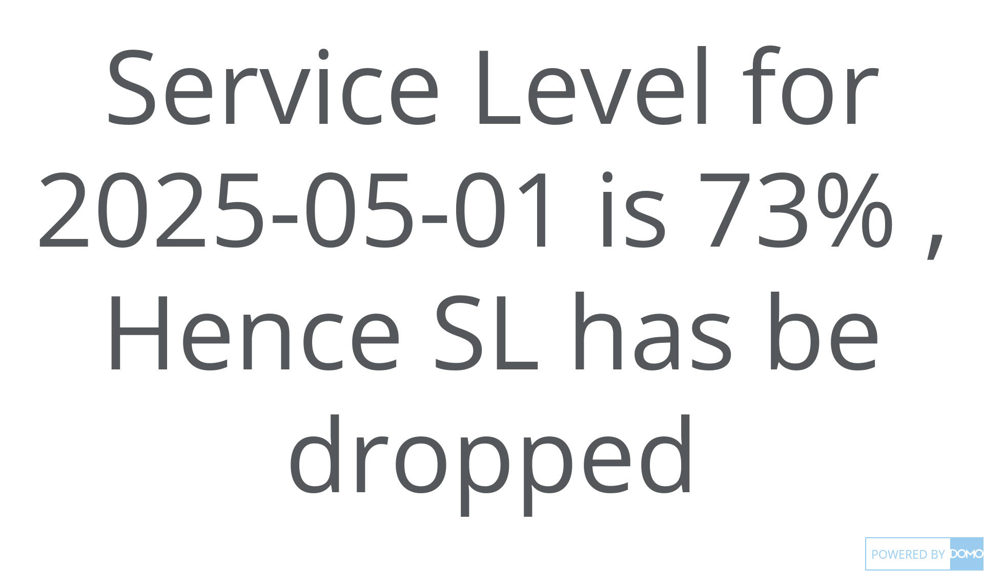
+
exported May 17, 2025, 12:37:00 PM UTC
PE3 | Card 11 | Service Level Insights
This Month, by Day

